Slide 1

Daily News Headline for Stock Market Prediction
Team 25: The Stock Divas
Members: Anastasia Gkousioudi, Wanying Ye, Cindy Chen, Tanya Gonzalez, and Swadha Rai
TA: Shermeen Velani

Slide 2





Daily News Headline for Stock Market Prediction
Team #25 - The Stock Divas
Yuexin(Cindy) Chen
Swadha Rai
Wanying Ye (Gloria)
Anastasia Gkousioudi
Tanya Gonzalez
Thanks Shermeen Velani (TA) for your guidance!

Slide 3
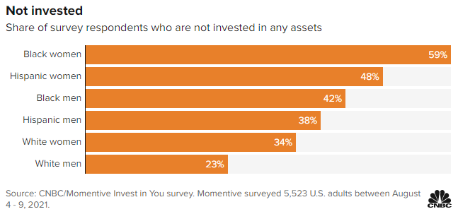
Introduction
In the United States, the racial and ethnic gap in wealth, such as people of color (POC) are less likely to invest.
The most important market indices in the U.S. stock market are the Dow Jones Industrial Average (DJIA), Standard and Poor’s 500 (S&P 500), and Nasdaq Composite.
As technology advances with Machine Learning, the computational intelligence approach in predictions can provide society with numerous trends to follow.

Slide 4




Datasets
Textual Data
News headlines from Reddit World News
Headlines ranked by users’ votes
Top 25 headlines per date
Financial Data
Stock market data from three stock indices
DJIA
Nasdaq Composite
S&P 500
Notes:
Data sources are reddit, djia, nasdaq composite, s&p 500
Found datasets on kaggle and yahoo finance
Stock market data includes date, opening and closing value, high and low value, adjusted closing value, and the volume of stocks that have been traded that day
Combined this data into a single dataset, 1989 days , 49000+ total headlines

Slide 5
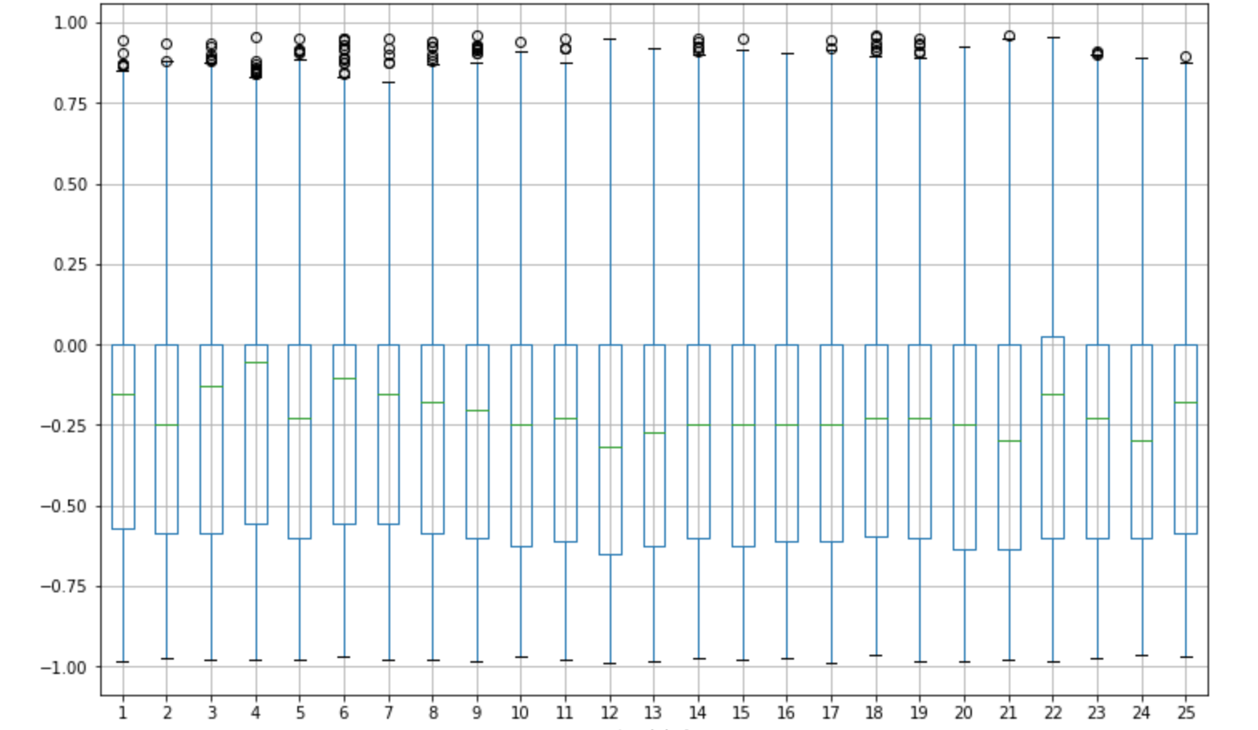
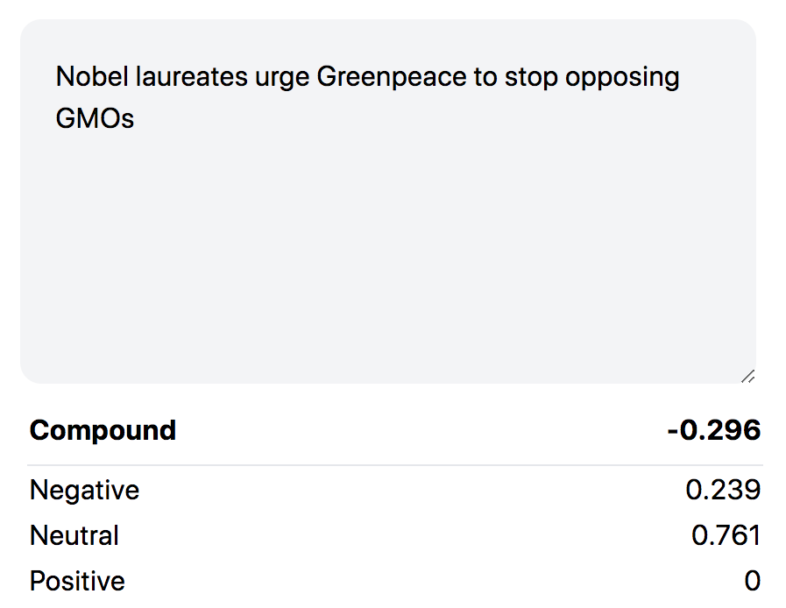
Exploratory Data Analysis (1/3)
VADER Compound Sentiment Values by Top Headline
https://vader.casadi.la/
VADER Compound Scores
Top Headline
Notes:
Found a sentiment web tool online
Looked through source code and found that it was using a library called VADER
Free tool, specifically for social media and we scraped from reddit
Used this tool to calculated the probability of each headline to be positive, negative, or neutral
Also calculated a compound value: best for a single value summary, scale of -1 to 1
Boxplot shows the average compound value, grouped by each top headline
For the most part, these median compound values fall between 0 to -.5, which means they are typically varying from neutral to negative
An example headline that falls near the median values is on the right

Slide 6
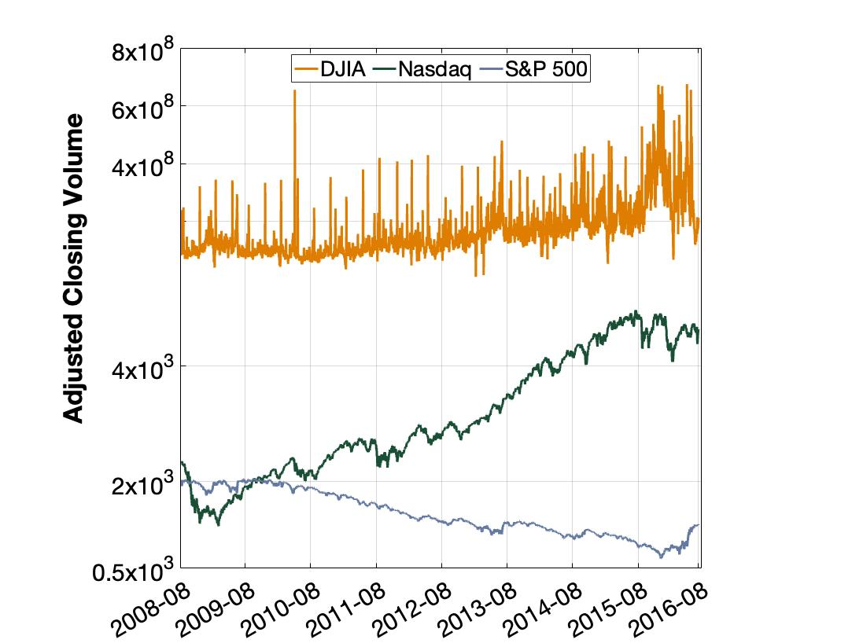
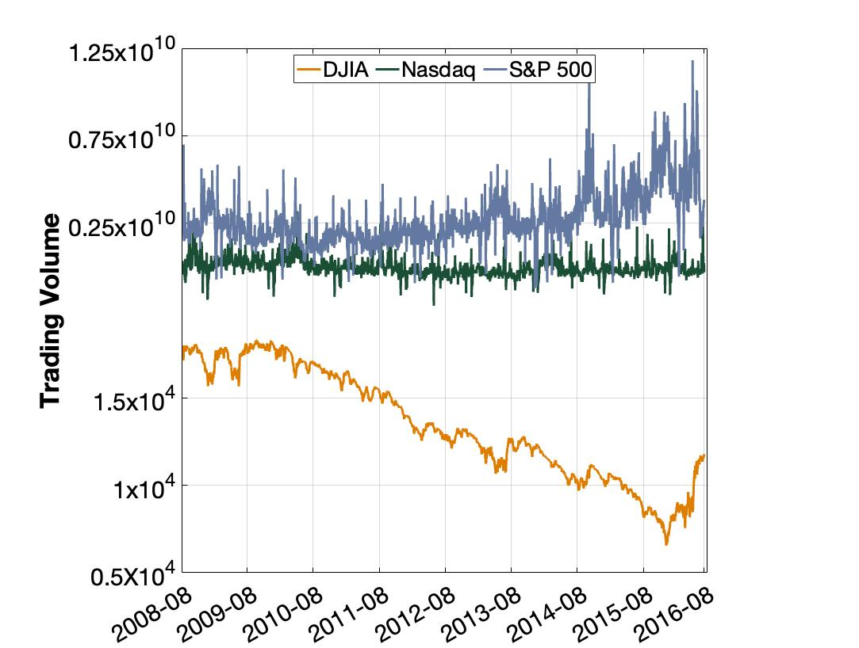
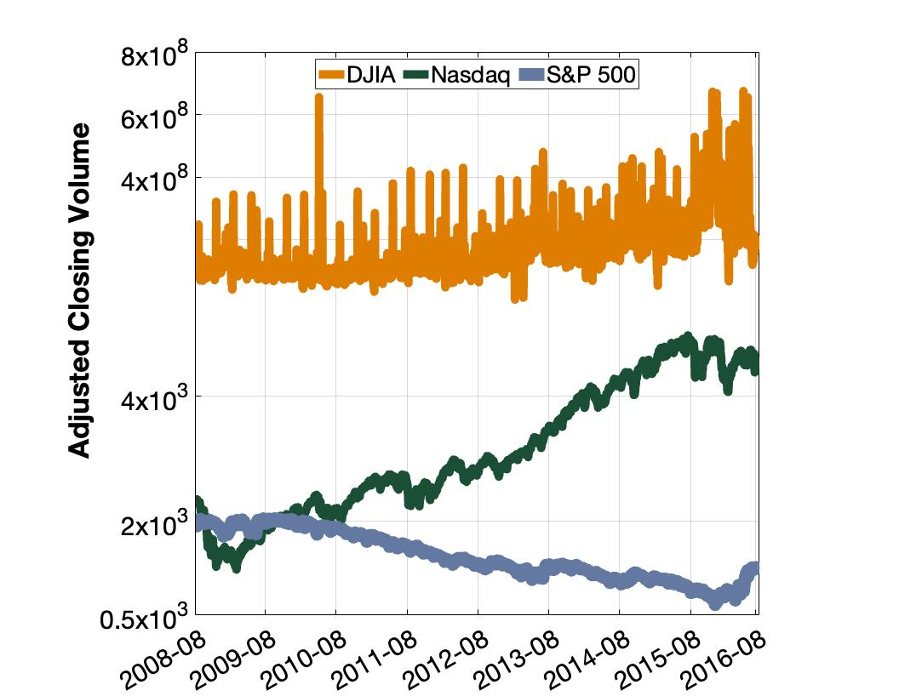
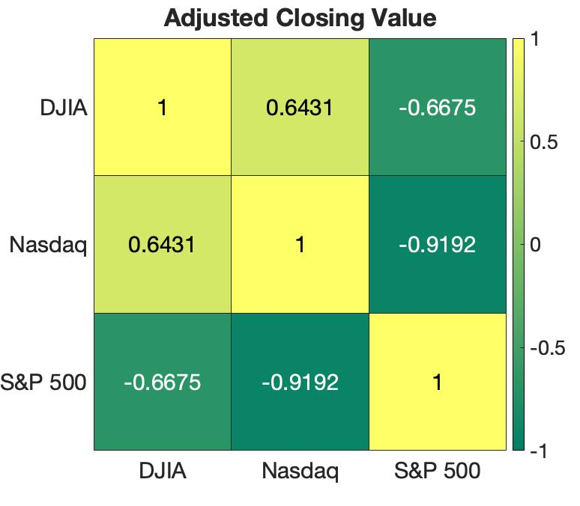
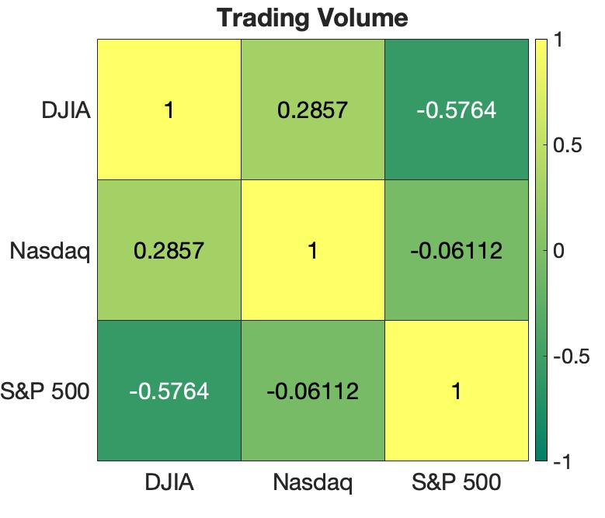
Exploratory Data Analysis (2/3)
.
.
.
.
.
.

Slide 7
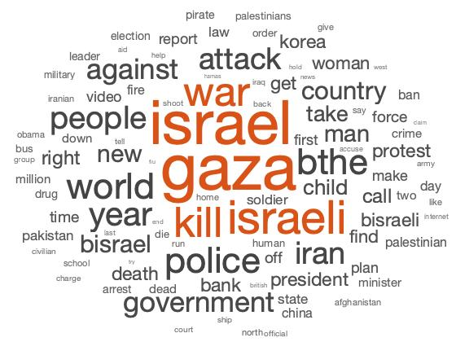
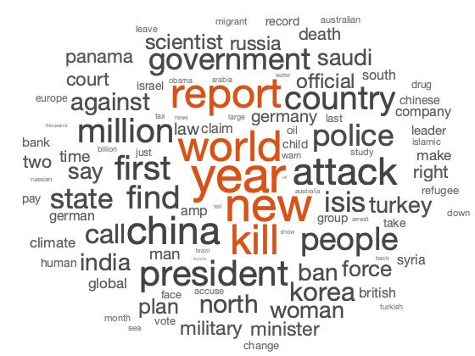
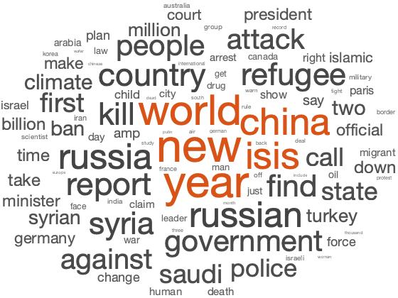
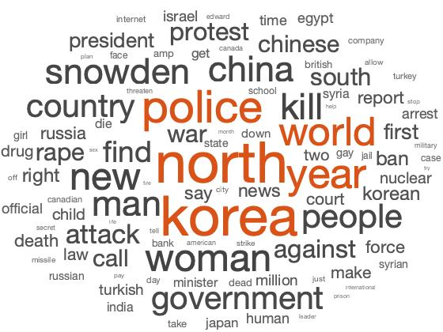
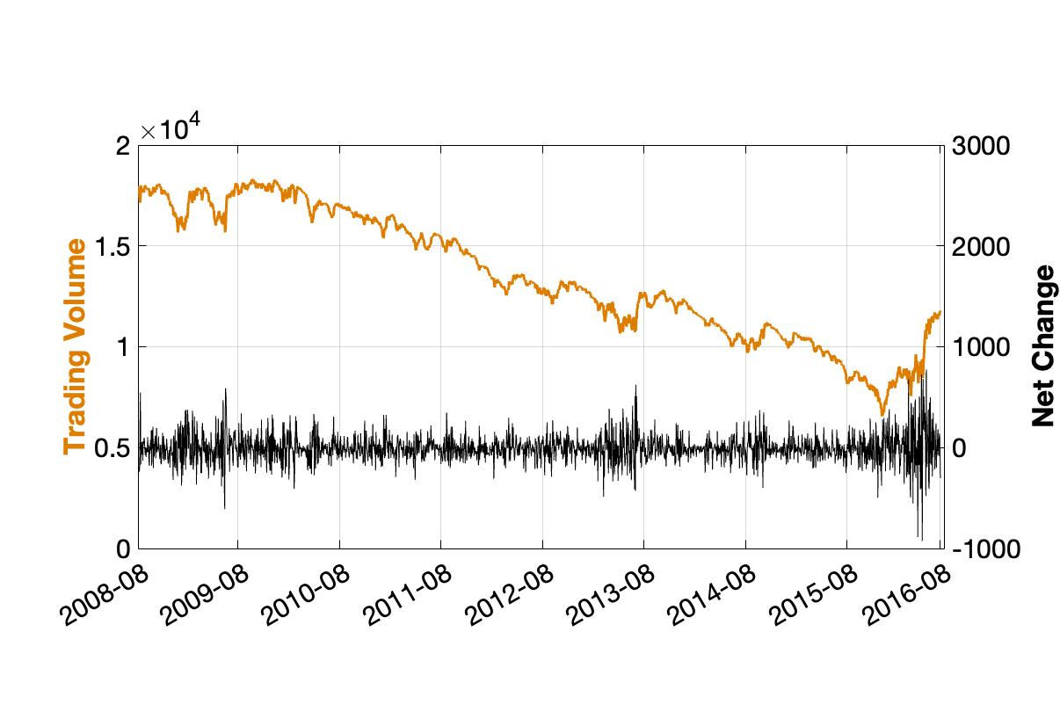
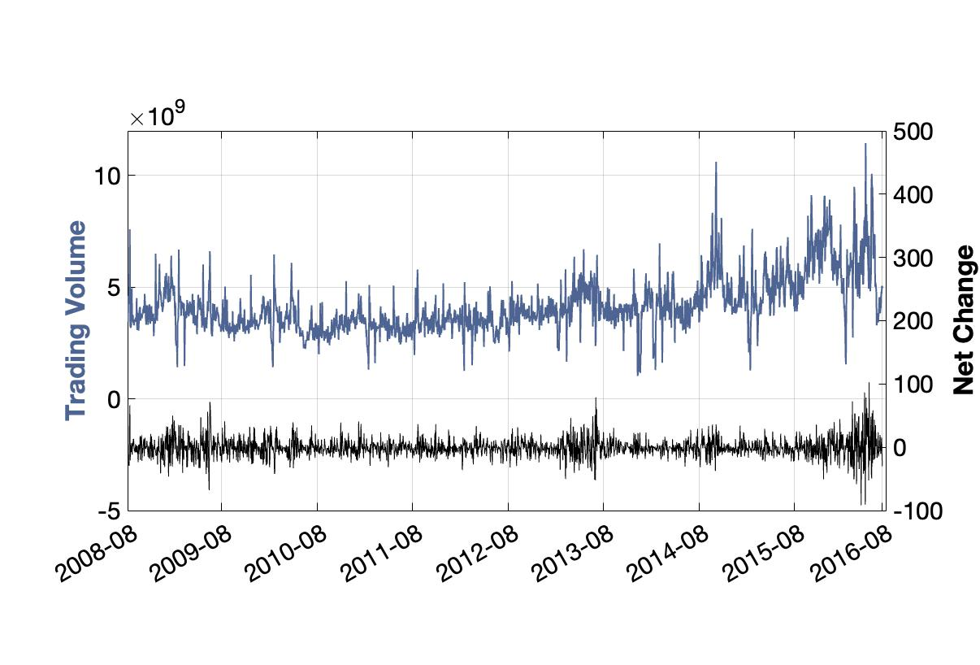
Exploratory Data Analysis (3/3)
Dow Jones Industrial Average
S&P 500

Slide 8
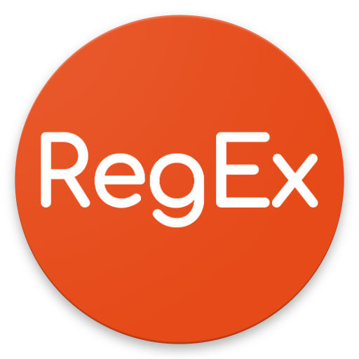

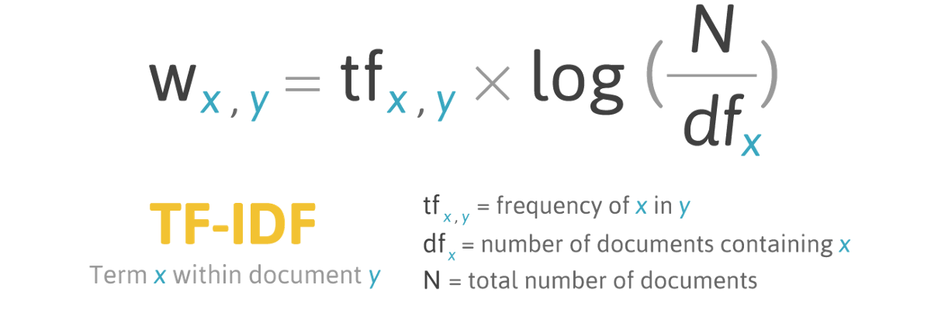
Data Preprocessing
Only extract the alphabetic letters
Lower case
Lemmatization (remember, remembered, remembering, rememberable -> remember)
Tokenization -> Remove irrelevant tokens and stop words (e.g. determiners, pronouns, conjunctions, etc.)
Raw
Remember that adorable 9-year-old who sang at the opening ceremonies? That was fake, too.
Preprocessed
remember that adorable year old sing opening ceremony be fake
Bag-of-words
TF-IDF
Word vectors
Words | Counts
remember | 1
adorable | 1
fake | 1
remember [-0.66, 1.10, …, 0.72]
…
adorable [-0.78, 0.58, …, 0.05]
……
fake [-0.71, 1.38, …, 0.40]
…
…
Notes:
Determiner: the, a, these
Pronoun: me, my, you, your, it
Conjunctions: and, or, but

Slide 9
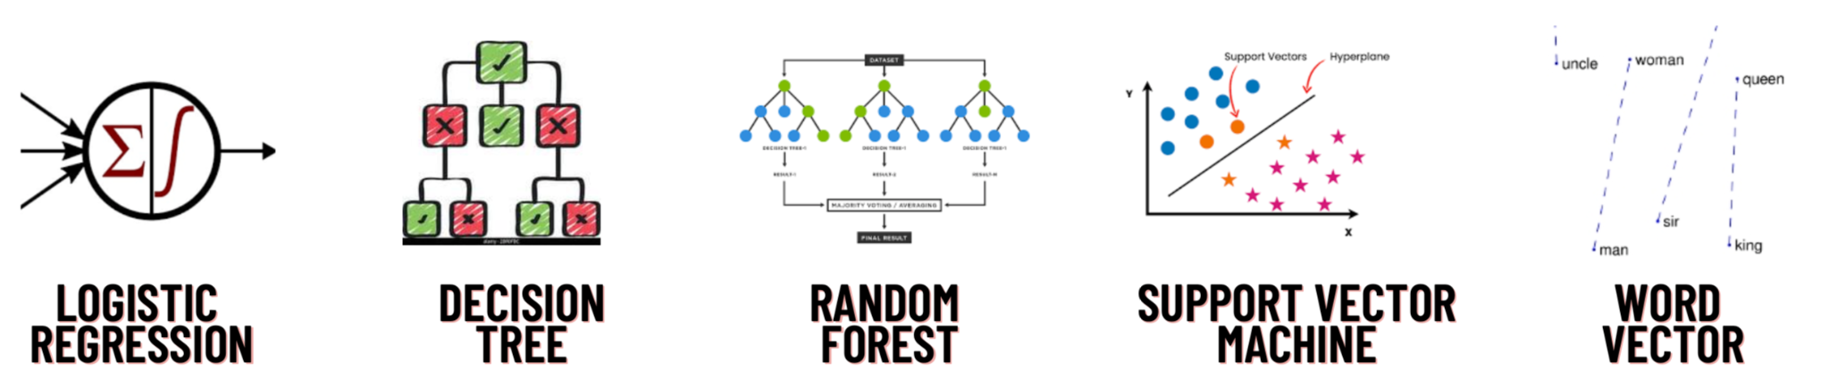
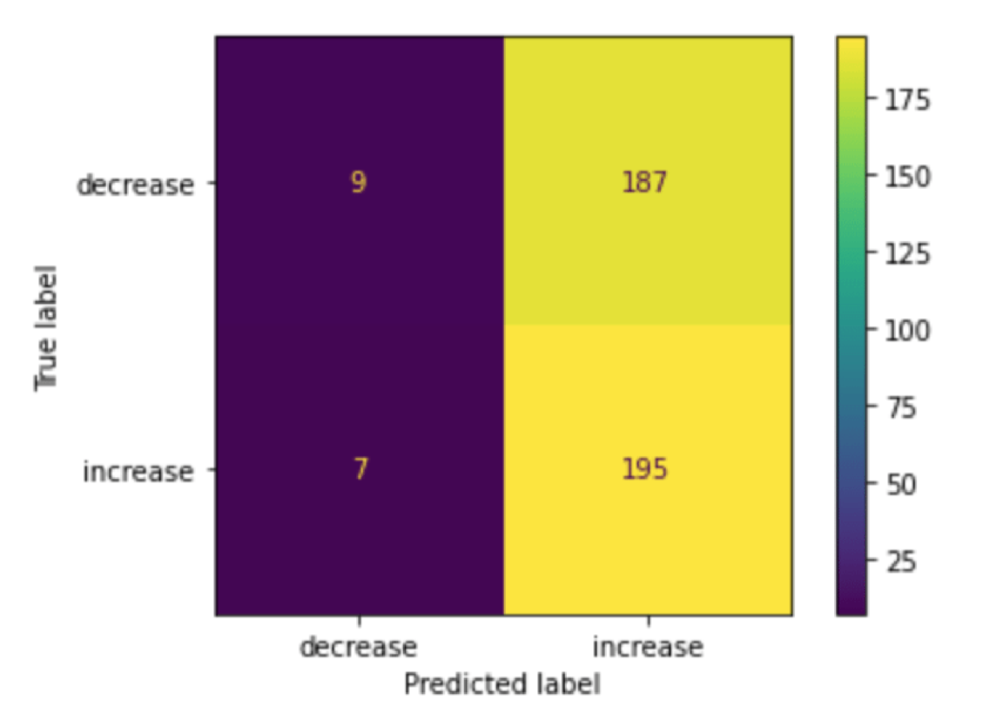
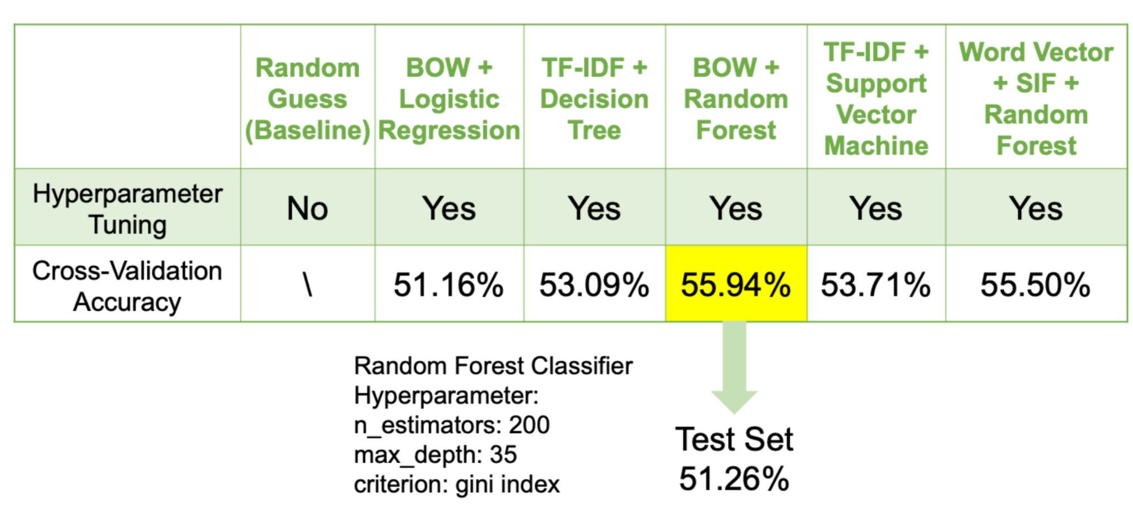
Modeling
Model Candidates
3. Final Model
Random Forest Classifier with Bag of Words (BOW) representation performed the best (5-fold CV: 55.94%).
Test set accuracy: 51.26%, better than random guesses.
2. Performance Evaluation
Confusion matrix of Random Forest Classifier on test set

Slide 10
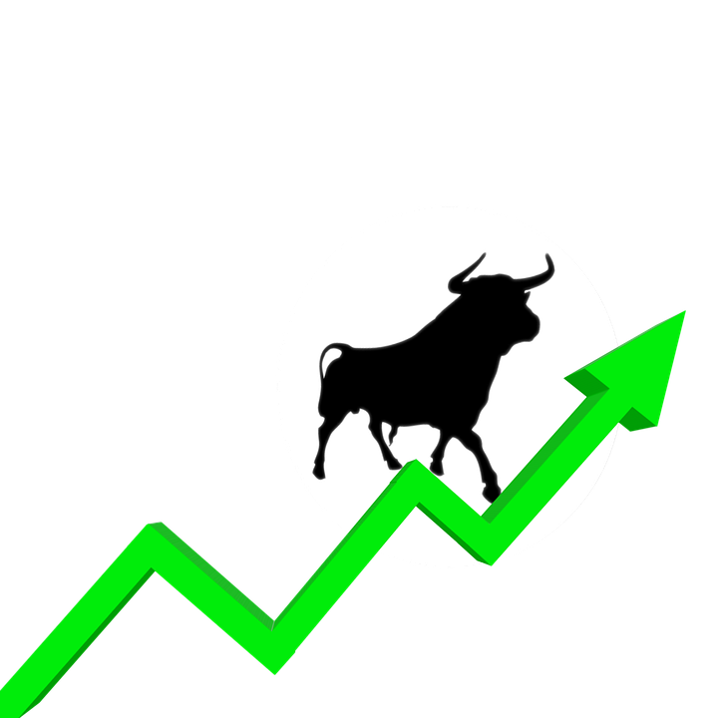
Conclusion
Our analysis concluded that the daily top world news headlines alone cannot predict the stock market well.
Further analysis revealed that either the stock market is not predictable in nature, or we are not including the important predictors.
DJIA and S&P 500 seem to follow opposite trends
We can confirm that machine learning in predicting the stock market with the daily news headlines will provide underrepresented communities with a new tool to invest

Slide 11
Wealth and rank are what people desire, but unless they are obtained in the right way they may not be possessed.
-Confucius

Slide 12
References
Alzazah et al., “Recent Advances in Stock Market Prediction Using Text Mining: A Survey”, IntechOpen, 2020
Ameisen, Emmanuel. “How to solve 90% of NLP problems: a step-by-step guide.” Insight Data Science, 2018
Chen, James. “What is the Stock Market?” Investopedia, 2022
Choudhury, Sharmila. “Racial and Ethnic Differences in Wealth Holdings and Portfolio Choices.” SSAm, 2002
Fox, Michelle, “As interest in investing grows, people of color still lag behind, CNBC survey finds.” CNBC, 2021
Horowitz et al., “MOST AMERICANS SAY THERE IS TOO MUCH ECONOMIC INEQUALITY IN THE U.S., BUT FEWER THAN HALF CALL IT A TOP PRIORITY”, Pew Research Center, 2020
Jaitly et al., “Forecasting Stock Market Trends Using News Headline Analysis”, IRJET, 2021
Kumbure et al., “Machine learning techniques and data for stock market forecasting: A literature review”, ESWA, 2022

